Slide 1
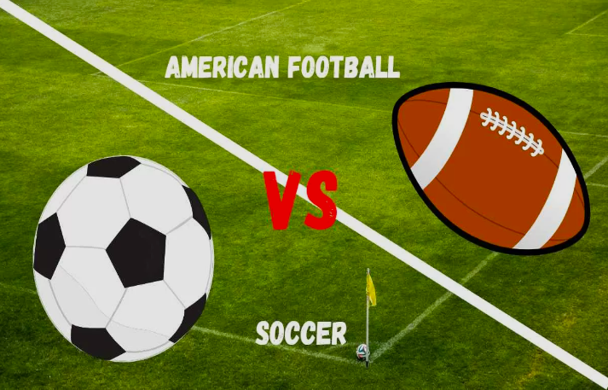
American Football vs Soccer
Dipika Jothinathan

Slide 2
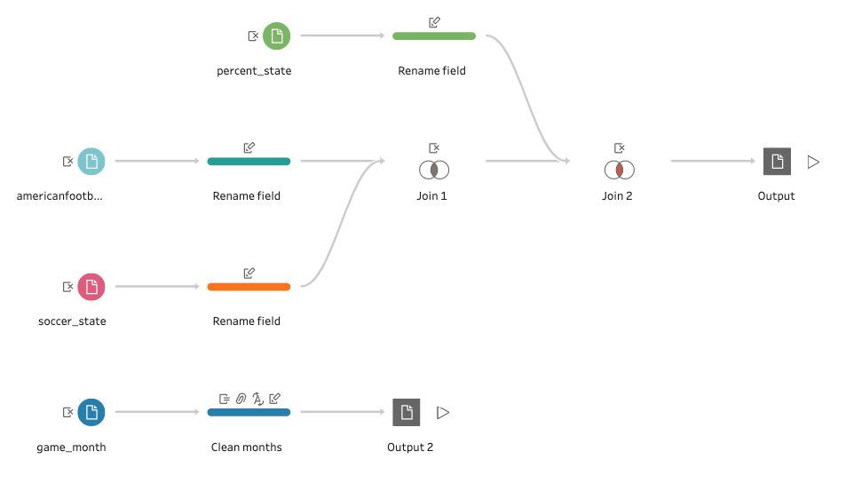
Data Cleanup using Tableau Prep Builder

Slide 3
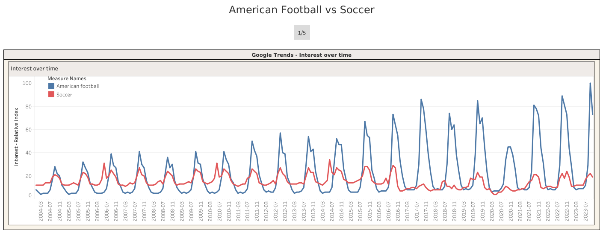
Story Pg-1: Game Interests (2004-Oct 2023)

Slide 4
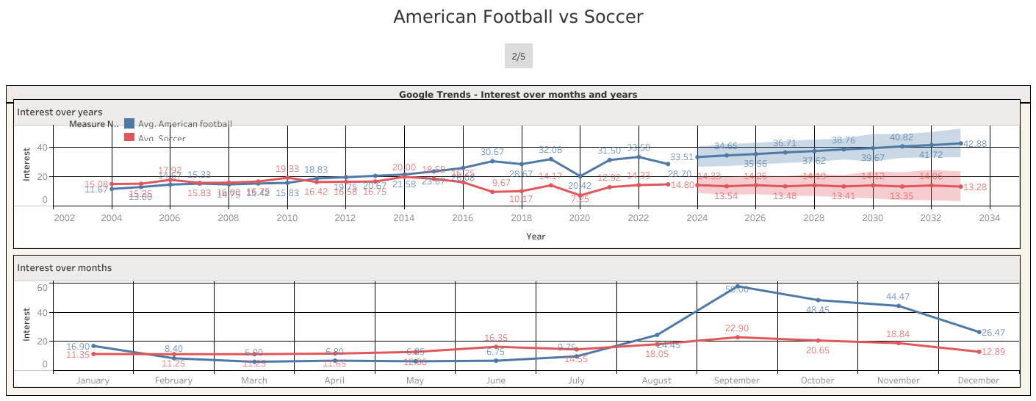
Story Pg-2: Game Interests vs Month, Year

Slide 5
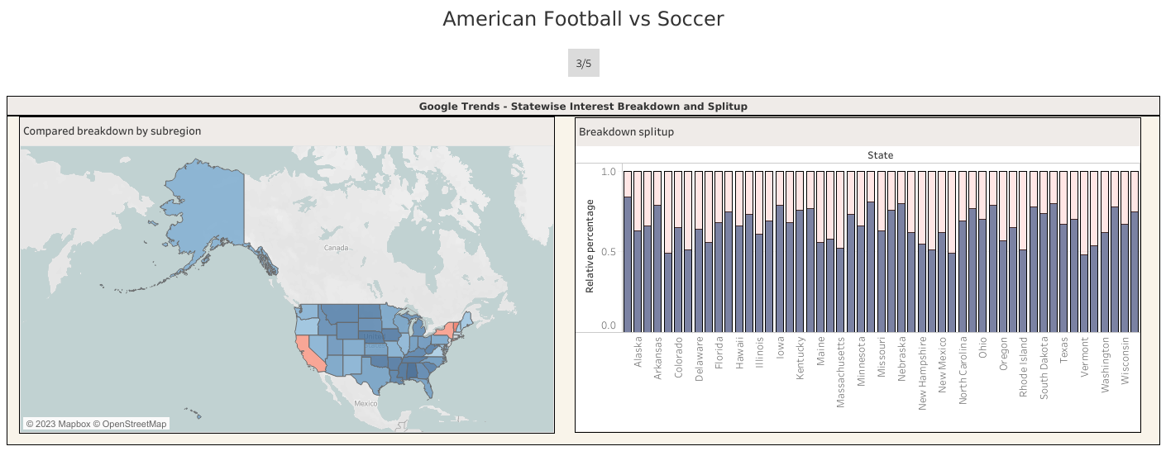
Story Pg-3: State-wise Interest Comparison

Slide 6
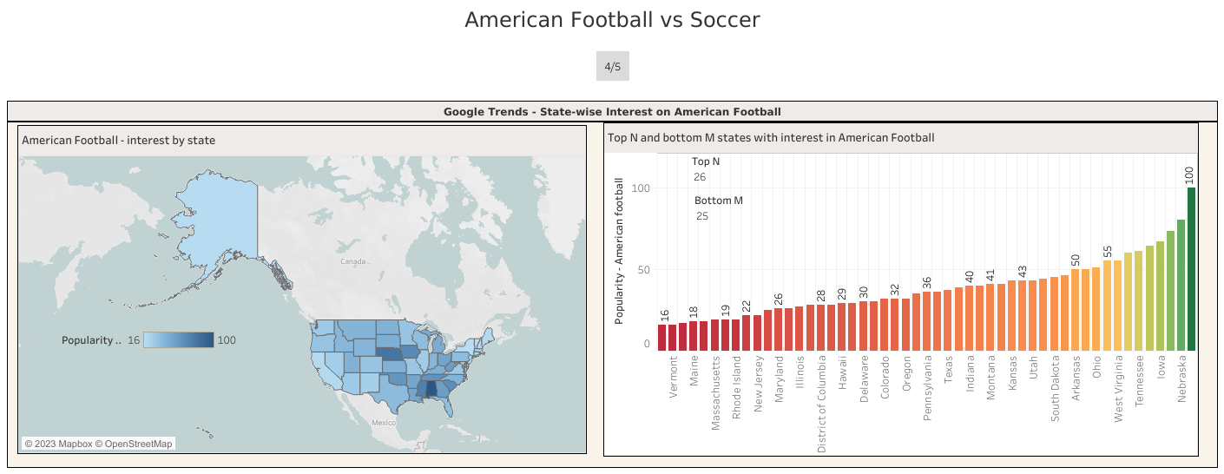
Story Pg-4: American Football vs States

Slide 7
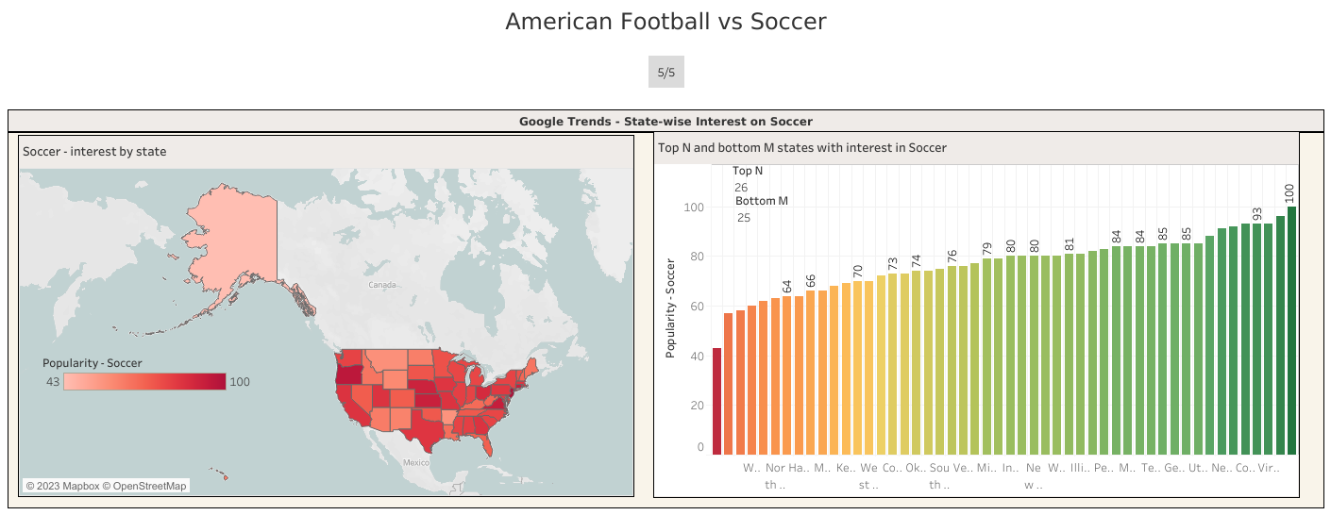
Story Pg-5: Soccer vs States

